Slide 1
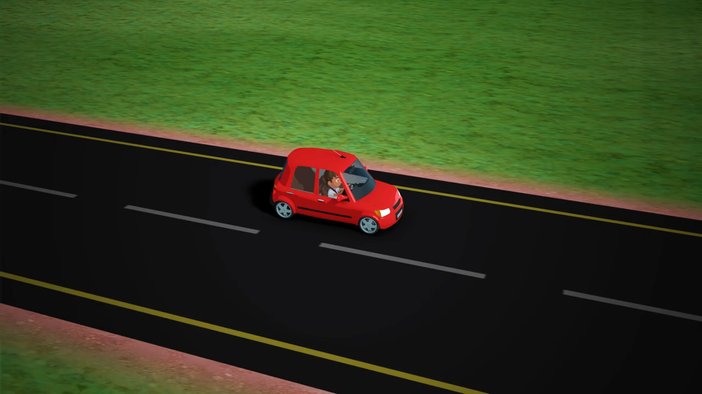

Slide 2
What is drowsy driving?
Drowsy driving means operating a motor vehicle when a person is unable to remain alert due to lack of sleep. Drowsy driving is also known as sleep deprived driving, fatigued driving or tired driving.
Driving in this state leads to slow, increased reaction time of stimuli. In some cases, the driver may also fall asleep behind the wheel. Sleep deprivation is a major cause of motor vehicle accidents, and it can affect the human brain as much as alcohol can.
Studies suggest that you are more likely to die from drowsy driving than from texting while driving, distracted driving or drunk driving combined.

Slide 3
Facts
21 percent of all fatal accidents are due to drowsy driving.
60 percent of adult drivers or about 168 million people have driven a vehicle while feeling drowsy in the past year.
About 37 percent or 103 million people have fallen asleep at the wheel, according to the National Sleep Foundation’s [NSF] 2005 poll.
4 percent or approximately eleven million drivers admit they have had an accident or near accident because they dozed off or were too tired to drive.
Sleep-related crashes are most common in young people between the ages of 18 and 29.
The National Highway Traffic Safety Administration estimates that 100,000 accidents are the direct result of driver fatigue each year.

Slide 4
Vehicular crashes result in an estimated 1,550 deaths, 71,000 injuries, and 12.5 billion dollars in monetary losses each year.
Drivers who slept 4 hours less had 10 times the crash rate of drivers who slept for regular times.
Shift workers are more likely [36 percent] than those who work a regular daytime schedule [25 percent] to be involved in crashes.
According to NSF’s 2000 Sleep, 42 percent of drivers said that they become stressed, get impatient and 12 percent said they tend to drive faster when they are driving drowsy.
Only about 22 percent of elderly drivers said they pull over to nap when driving drowsy.
Most crashes occur between 4 to 6 a.m.; midnight to 2 a.m. and 2 to 4 p.m. Nearly 23 percent of adults admit that they know someone personally who has crashed due to falling asleep at the wheel.

Slide 5
Causes
Lack of adequate sleep. Around 7 to 8 hours of sleep daily at night is essential for the human body. Fatigue-related accident is much higher, if you have been awake for more than 18 hours.
Driving long distances alone along vast boring stretches of road.
The presence of untreated or unrecognized sleep disorders such as obstructive sleep apnea or narcolepsy [a disorder of the nervous system which causes excessive daytime sleepiness]. Habitual snoring and depression also cause daytime drowsiness.
Driving at times of the day when you would normally be sleeping. Your body and brain are regulated by your biological clock, also known as the circadian rhythm, which influences how alert or drowsy you are at certain times of the day.
Taking medications which have drowsiness as a side effect.

Slide 6
Effects of Sleep Deprivation on Driving Performance
You are constantly rubbing your eyes and yawning.
There is difficulty in focusing, frequent blinking, or heavy feeling in eyelids.
You have difficulty in keeping your head up or your head is bobbing continuously. Sleepiness or nodding off makes it harder to react to events going on around you.
Drowsy drivers often miss exits or traffic signs and misjudge distances. There is inability to focus or clearly remember the road directions and signs.
Slow reaction to stimuli.
Decreased accuracy in responses.
Long lapses in attention.
Inability to stick to one lane, tailgating, or the driver may even hit the curb or shoulder rumble strip.
Increased moodiness and aggressive behaviors. Tired, restless and irritable drivers are more prone to road rage and speeding.

Slide 7
Driver Drowsiness Detection System

Slide 8
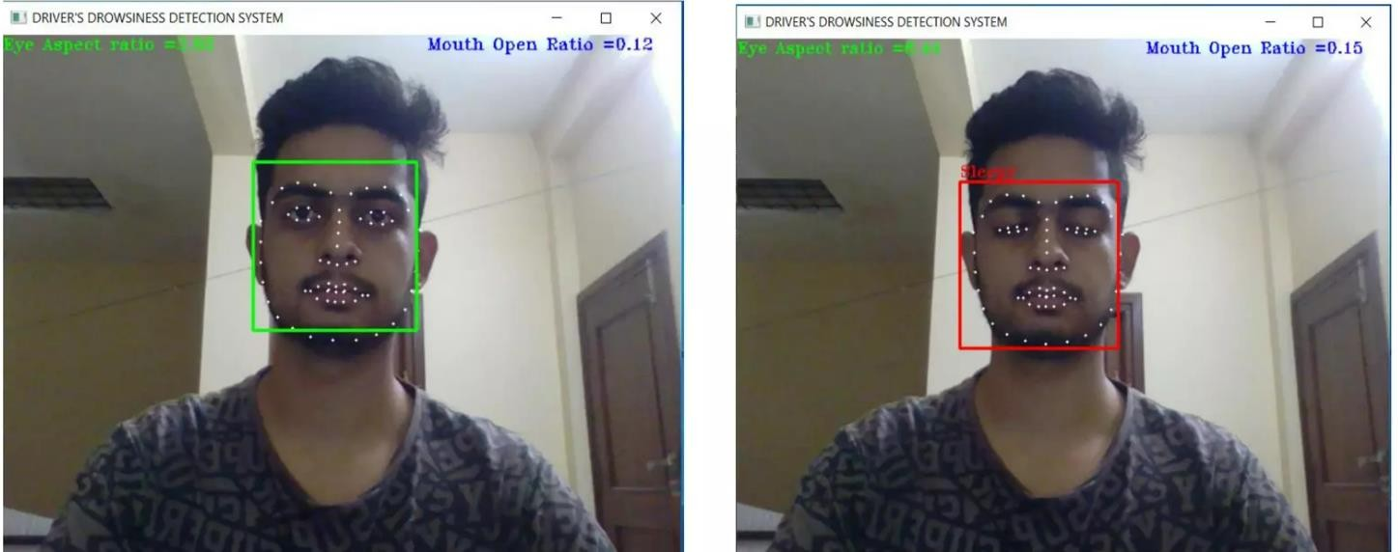
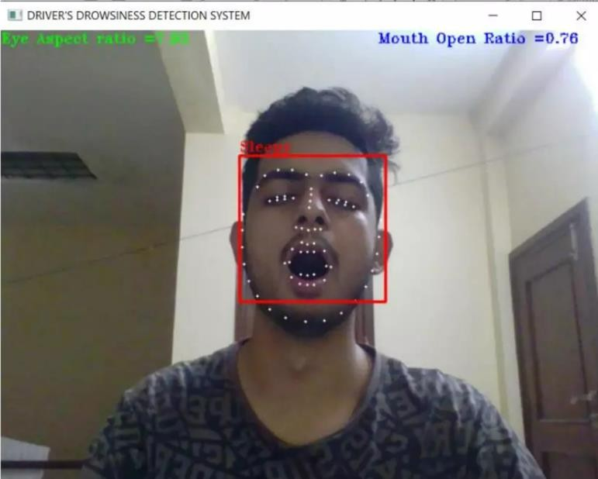

Slide 9

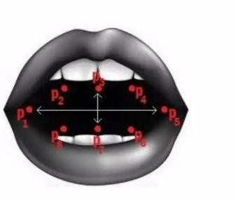
EAR <.40
Eye Aspect Ratio = ||p2-p6|| + ||p3-p5|| / 2||p1-p4||
MAR<.38
Mouth Aspect Ratio = ||p2-p8||+||p3-p7||+||p4-p8|| / 2||p1-p5||

Slide 10
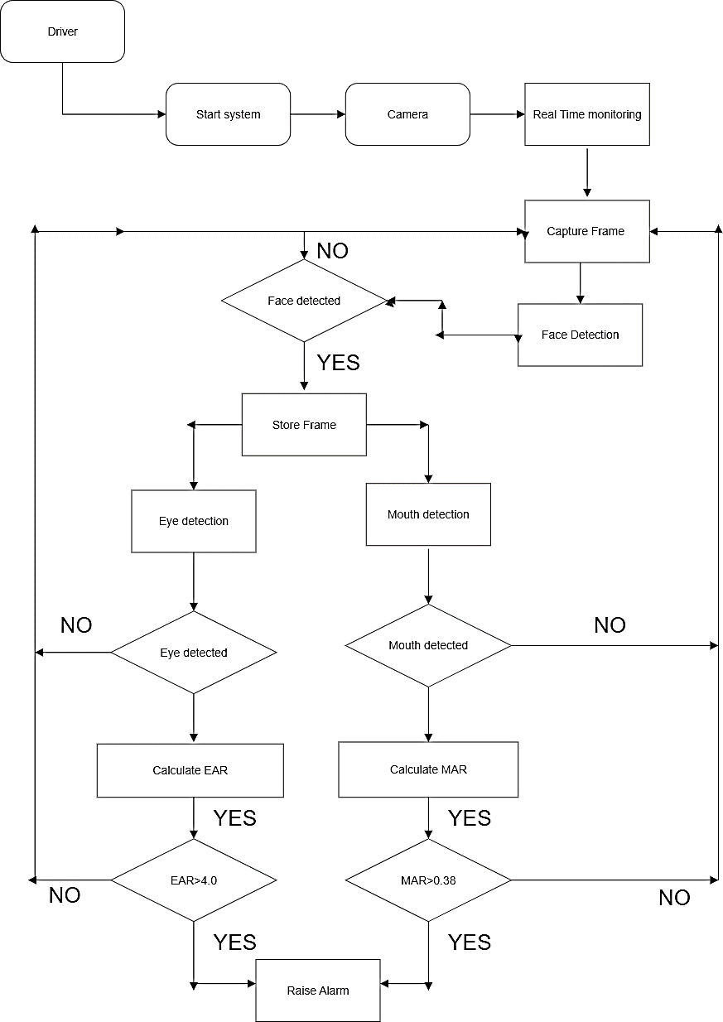
EAR<.4
MAR<.38

Slide 11
Use cases:
Automotive industry: Driver drowsiness detection systems can be integrated into vehicles to alert drivers, when they show signs of fatigue, helping to prevent accidents caused by drowsy driving.
Long-distance trucking: Long-haul truck drivers who spend hours on the road can benefit from drowsiness detection systems, which can alert them when they need to take a break.
Public transportation: Bus and train drivers can use drowsiness detection systems to stay alert during long shifts and to ensure the safety of passengers.
Military and aviation: Pilots, military personnel, and other professionals who operate vehicles or machinery in high- stakes environments can use drowsiness detection systems to stay alert and focused.

Slide 12
Tips to Stay Awake While Driving
Get a good night’s sleep before the start of a long trip. Make sure to get seven to eight hours of sleep at night. Taking a short nap before a road trip can also help make up for a shortfall in sleep.
Plan for one break every two to three hours on the road or every 100 miles.
Don’t travel for more than eight to ten hours a day.
Stop driving when you feel drowsy. Pull over in a safe spot, have a cup of coffee or take a short nap of about twenty minutes.
Drive with a buddy when doing long trips.
Have someone else do the driving in turns when you are feeling groggy.
Do not drink any alcohol before driving. It will compound the effects of sleepiness or tiredness.

Slide 13
Have someone in the front seat keep an eye on the driver. Ask driver to pull over in a safe place when he is sleepy or exhibiting signs of fatigue.
Avoid peak sleepiness periods from midnight to six in the morning. Choose to sleep overnight instead of driving through the night.
Avoid medications as a side effect.

Slide 14
ReferenceS
https://www.medindia.net/patientinfo/drowsy-driving.htm
https://youtu.be/fVl88Q5DJ2w

